Slide 1
Java Exceptions

Slide 2
Reading Files Review
public static void main(Strings[] args) {
try {
Scanner fileHandler = new Scanner(new File(“file.txt”))
while(fileHandler.hasNext()) {
dosomething(fileHandler.nextLine()); // method that handles strings
}
}catch(IOException io) {
System.out.println(“error”);
}
}
What is this??

Slide 3
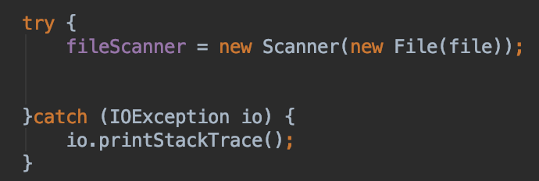
Controlling Errors
We can’t control every possible error situation
For example:
What happens if the file is not there?
What if you don’t have permission to read it?
Not just files
What about network connections?
What if printers aren’t there?
Introducing
try – catch
and exception handling

Slide 4
Try - Catch
try
try a block of code.
If it runs properly, great!
catch
an error happened!
run the catch block of code
throws
allows you to “throw” the exception
requires someone else to handle it
Exception
an object / class we use for errors!
You can write you own
or use built in cases
Checked or Unchecked
Checked requires try/catch
IOException - Input / output exception - checked
FileNotFoundException - Subset of IOException, but allows you to specify exactly that it is file not found - checked
ArrayIndexOutOfBoundsException - you don’t usually try/catch this, but you can - unchecked
NullPointerException - you don’t usually try/catch this - unchecked
NumberFormatException - Shows up when you take a string that doesn’t look like a number, and try to make it a number - unchecked

